Slide 1
The Nyckelharpa

Slide 2
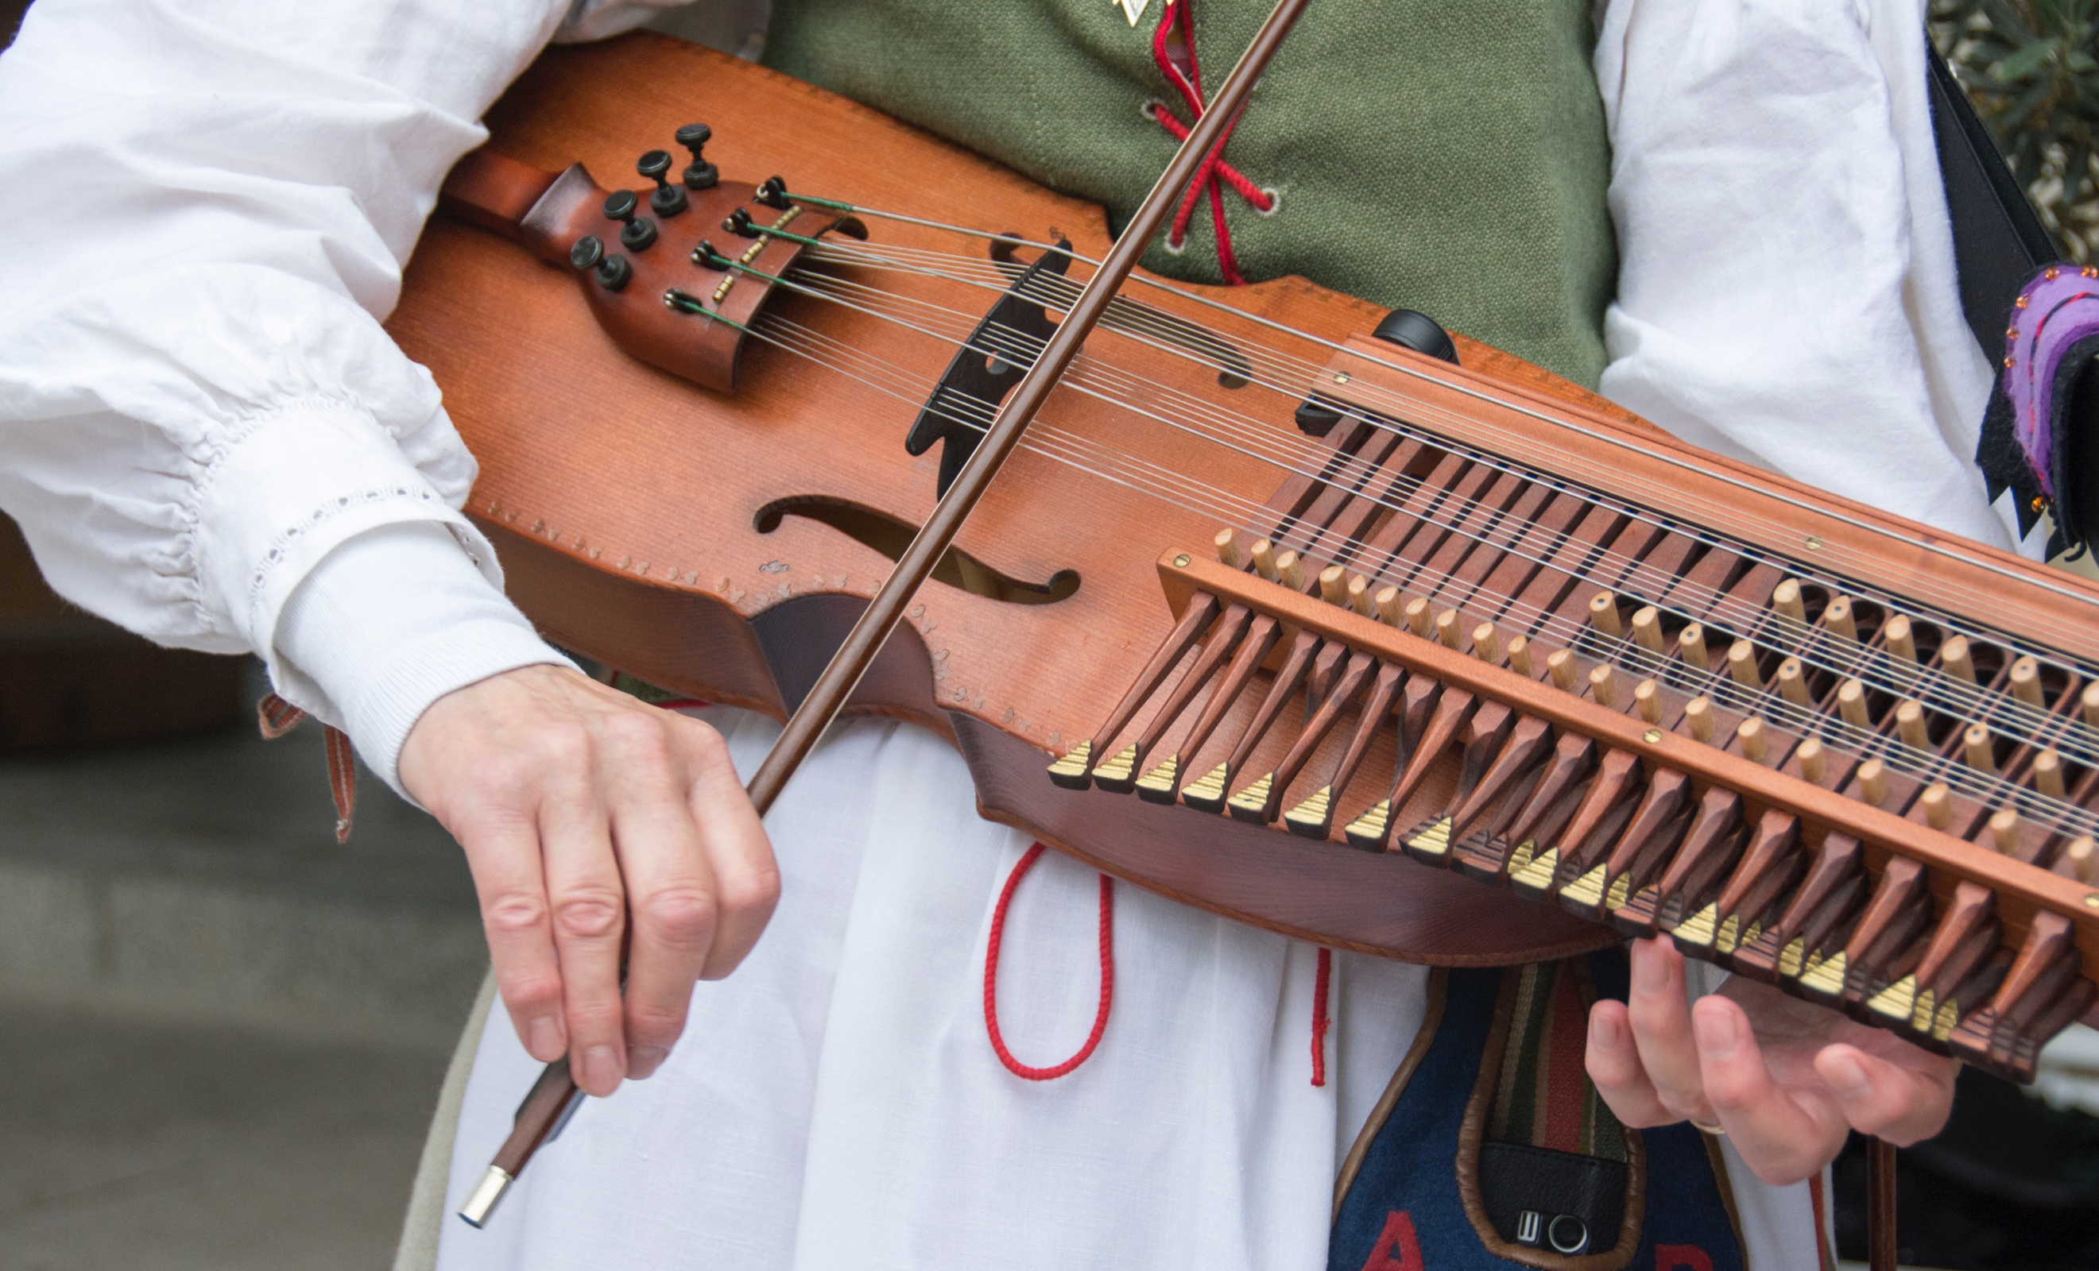
What is a “Nyckelharpa”?
The nyckelharpa is a bowed chordophone- meaning a musical instrument that produces sound from the vibrations made by a stretched string being depressed. In this case the strings are pressed down by a bow.
The nyckelharpa is keyed. Keys are held in place on the neck on the instrument and are pressed down by the fingers of the musician.
There are two distinct shapes of the nyckelharpa. A figure-eight shape and a boat shape.

Slide 3
History of the Nyckelharpa
The nyckelharpa originated from Scandinavia, more specifically an Eastern province of Sweden known as Uppland.
The earliest pictorial evidence of the nyckelharpa being used are in 15th and 16th century paintings.
Only a few hundred musicians played the nyckelhapa in the mid-20th Century, however, there was a renewal of interest in the 1970’s.
It is now also heard in other genres other than traditional music. It’s popularity also spread beyond the Scandinavian region as British persons and Americans have participated in The World Championships in nyckelharpa playing.

Slide 4
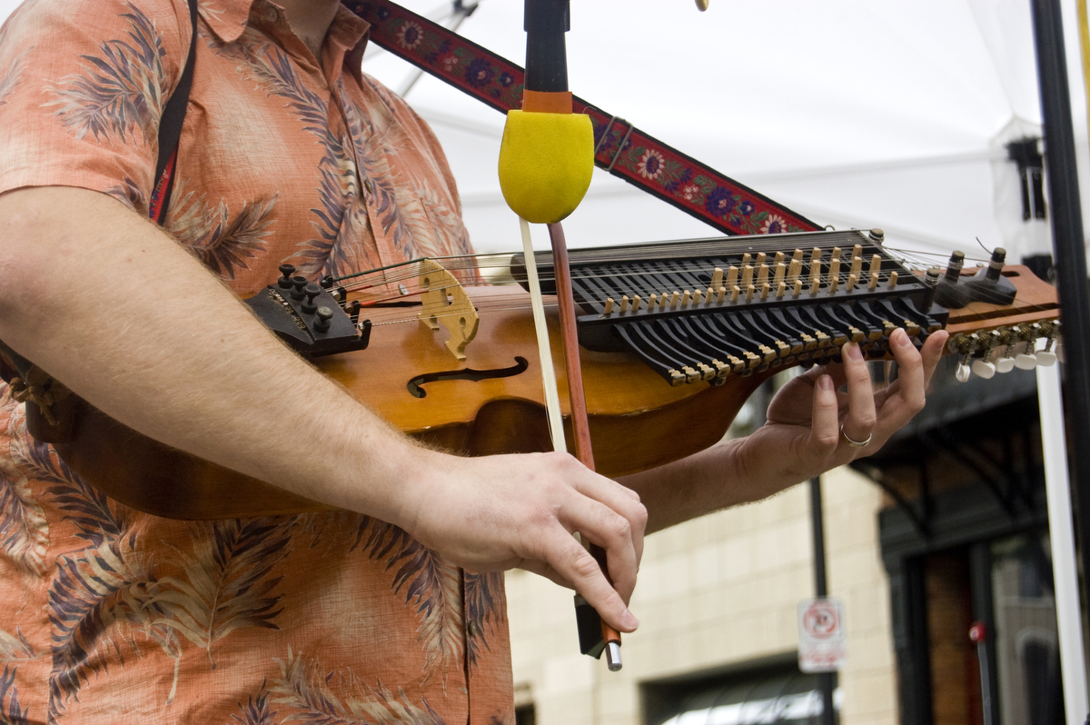
Discussion Questions
Can you think of any other chordophones that musicians play today?
What other instruments have the same shape as the nyckelharpa?
Theoretically, if one “modern” instrument was to lose its popularity over time, which instrument do you think it would be?

Slide 5
YouTube Video
https://www.youtube.com/watch?v=oAROWiX5MGw
Does the sound of these instruments remind you of any instrument/genre of music you have heard before?
Do you think that this instrument would work well with “pop” music?
Do you think that the nyckelharpa will continue to grow in popularity? Would you consider playing the nyckelharpa?

Slide 6
Bibliography
Brown, Howard Mayer, Frances Palmer. “Chordophone”. In Grove Music Online. Oxford University Press. Accessed June 24, 2018. https://doi.org/10.1093/gmo/9781561592630.article.05673
Fredelius, Gunnar. “Nyckelharpa”. In Grove Music Online. Oxford Univeristy Press. Accessed June 24, 2018. https://doi.org/10.1093/gmo/9781561592630.article.20187
From Flickr: “iwishmynamewasmarsha”- Nyckelharpa. Accessed June 24, 2018. https://www.flickr.com/photos/morganmorgan/27986752943/in/photolist-aui4ww-aufpgM-aufphKJD6qBa-331N8r-331NCR-336kuC-331Puk-331N3g-336n1m-336jMq-331P9V-331NR4-331PcR-336mcY-331PgH-3MmwXH-ajj8gG-EtsB31-4mwA9W-331NqX
From Flickr: “The Ann Arbor News”- 090311_ENT_Dancing in The Streets. Accessed June 24, 2018. https://www.flickr.com/photos/annarborcom/6114444314/in/photolist-aui4ww-aufpgM-aufphK-JD6qBa-331N8r-331NCR-336kuC-331Puk-331N3g-336n1m-336jMq-331P9V-331NR4-331PcR-336mcY-331PgH-3MmwXH-ajj8gG-EtsB31-4mwA9W-331NqX

